Slide 1
AI and machine learning problems
AI - ability of a computer or machine to mimic or imitate human intelligent behavior and perform human-like tasks
ML - subset of AI that has the ability to automatically learn from the data without explicitly being programmed
All machine learning is AI, but not all AI is machine learning
Machine Learning
It is a science that grew up from AI
The term, ML, was coined in 1959, by Arthur Samuel
A computer program is said to learn from experience E, with respect to some task T and performance measure P if its performance at task T, as measured by P, improves with experience E. (Tom M. Mitchell)

Slide 2
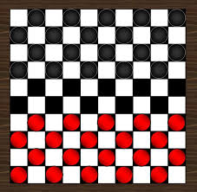
Checkers learning problem
Task T: playing checkers
Performance measure, P: % of games won against opponents
Training Experience, E: Playing practice games against itself

Slide 3
Handwriting Recognition Problem
Task T: Recognizing and classifying handwritten words/characters within images
Performance measure P: % of words/characters correctly classified
Training Experience, E: Predicting the word/character from a collection of handwritten words/characters with given classifications
MNIST Dataset (Yann Lecunn et al.)
BanglaLekha Isolated (Nabeel Mohammed, Sifat Momen et al.)
https://data.mendeley.com/datasets/hf6sf8zrkc/2
Dataset comprises of 50 Bangla basic characters, 10 Bangla numerals and 24 selected compound characters (total of 1,66,105 handwritten character images)
Bangla Sign Language Dataset (Intisar Tahmid Naheen, Riasat Khan et al.)
Deep Learning-based Bangla Sign Language Detection with an Edge Device
Bangla sign language dataset of 49 classes and approximately 80 images for every class
https://doi.org/10.1016/j.iswa.2023.200224

Slide 4
Student Admission Prediction Problem
Task T: Classifying students’ admissions into categories/rankings of universities
Performance measure P: % of students’ admissions correctly classified
Training Experience, E: Predicting the categories/rankings of universities from a collection of dataset with given classifications
Masters and Doctor of Philosophy admission prediction of Bangladeshi students into different classes of universities (Md Naimul Islam Suvon et al.)
400 data for PhD students and 300 for the MS candidates
Nine classes of universities according to QS world university rankings

Slide 5
Classifying an incoming email as either a spam or not spam
Task T: Correctly classify an email as either spam or not spam
Performance measure, P: % of emails correctly classified
Training Experience, E: A database of emails with proper labeling as either spam or not.

Slide 6
Robot driving learning problem
Task T: driving on public highways using vision sensors
Performance measure, P: Average distance travelled before an error (as judged by a human observer)
Training Experience, E: A sequence of images and steering commands recorded while observing a human driver.

Slide 7
Different types of learning
Supervised learning
Semi-Supervised learning
Unsupervised learning
Reinforcement learning

Slide 8
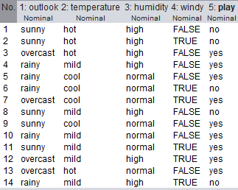
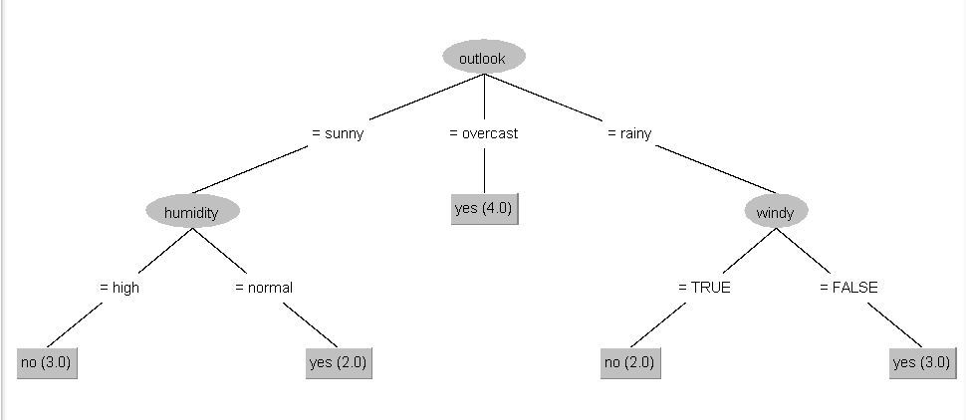
Supervised Learning: Classification Problem
In supervised learning, the algorithm builds a mathematical model from a set of data that contains inputs and desired outputs <X, y>.
Training data fed to algorithm includes the desired answers/solutions (labels)
y : target variable, output, dependent variable, class, label: Classification (Binary) problem
X: input variable, attributes, features, independent variable
Discrete value output (Male or Female, True or False, Yes or No)
The data contains 14 instances/records/samples and 4 attributes. The target variable is play
Decision Tree Model

Slide 9
Supervised Learning
Data:
1. Qualitative: Non-numeric/Categorical (hair color);
2. Quantitative (numeric)
Quantitative (numeric): Discrete (certain specfic value); Continuous (any value)
output y decides classification or regression problem
Classification (y categorial/discrete)
Classification algorithms are used when outputs are restricted to some discrete set of values
E.g. classifying whether an email is a spam email or not, whether a tumor is malignant or benign.
Classifying from medical records whether a pregnancy is high risk or not.
Classify the species of iris https://en.wikipedia.org/wiki/Iris_flower_data_set
Regression (y numeric and continuous)
Regression algorithms are used when outputs have continuous values i.e., they may have any value within the range.
E.g. predicting the price of a house from location, size of the area and number of rooms

Slide 10
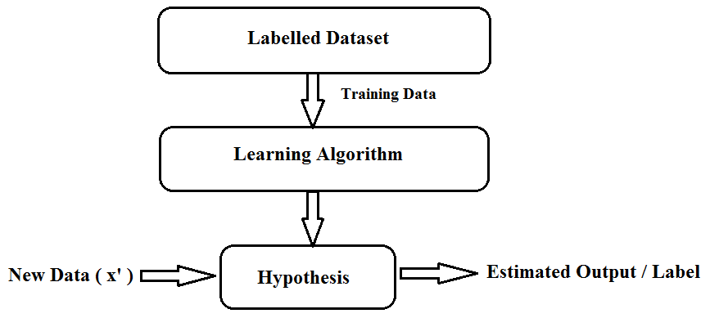

Supervised Learning
ML algorithm uses the training dataset to create a model/assumption/hypothesis which can be used to predict (unseen/new data)
ML algorithm iteratively makes predictions on the training data and is corrected by the output/supervision of teachers
<X, y>.
($\tilde{y}/y^{′})$

Slide 11
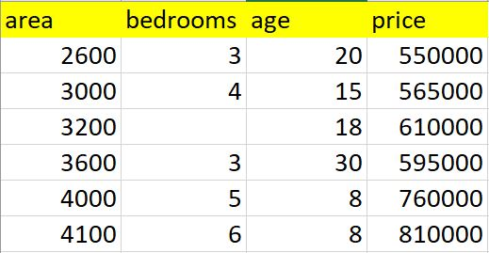
Supervised Learning: Regression Problem
Below is the table containing home prices in Monroe twp, NJ. Here price depends on area (square feet), bedrooms and age of the home (in years). Given these prices we have to predict prices of new homes based on area, bedrooms and age.
Given these home prices find out price of a home that has,
3000 sqr ft area, 3 bedrooms, 40 year old
2500 sqr ft area, 4 bedrooms, 5 year old
Regression problem: continuous value output

Slide 12
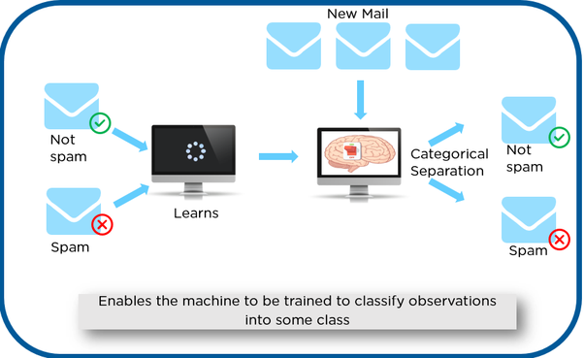
Supervised Learning - Classification

Slide 13
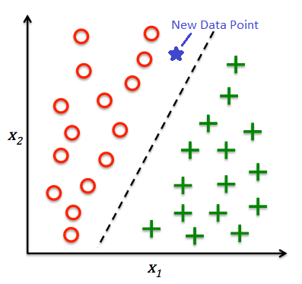
Supervised learning - Classification

Slide 14
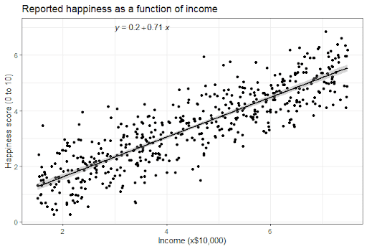
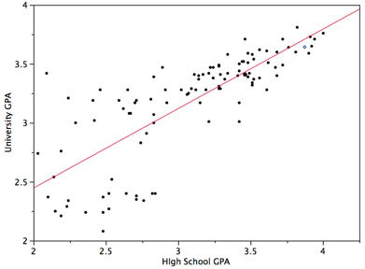
Regression

Slide 15
Unsupervised Learning
Unlabeled dataset
System learns without direct human supervision
Unsupervised learning algorithms take a set of data that contains only inputs, and find structure/patterns in the data, like grouping or clustering of data points.
The algorithms therefore learn from data that has not been labeled, classified or categorized
Instead of responding to feedback, unsupervised learning algorithms identify commonalities in the data and react based on the presence or absence of such commonalities in each new piece of data.
Useful for business intelligence

Slide 16
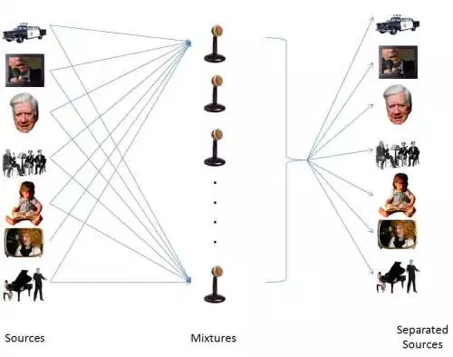
The Cocktail Party Problem
Encountered when sounds from different sources in the real-world mix in the air before arriving at the ear
Separate independent sources from a mixed signal

Slide 17
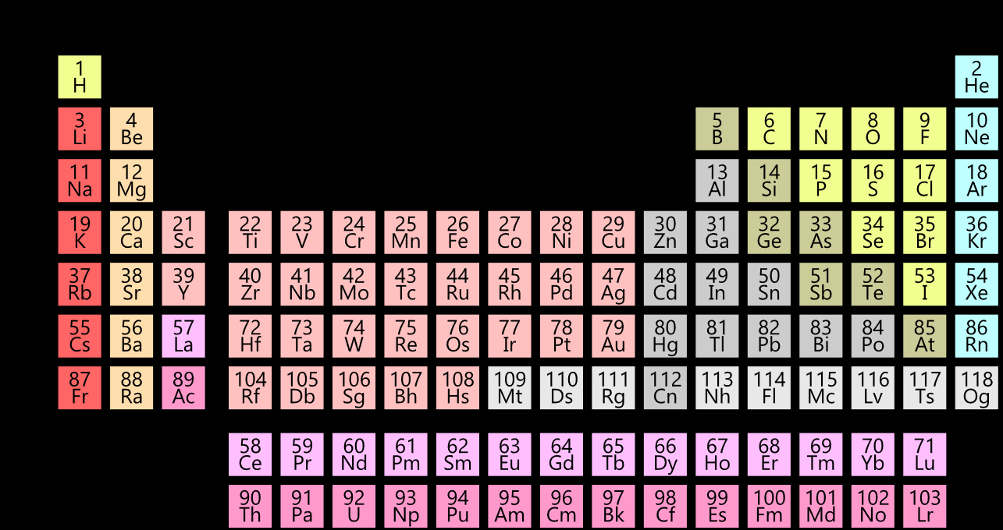
Unsupervised Learning
Recreation of the periodic table with an unsupervised machine learning algorithm

Slide 18
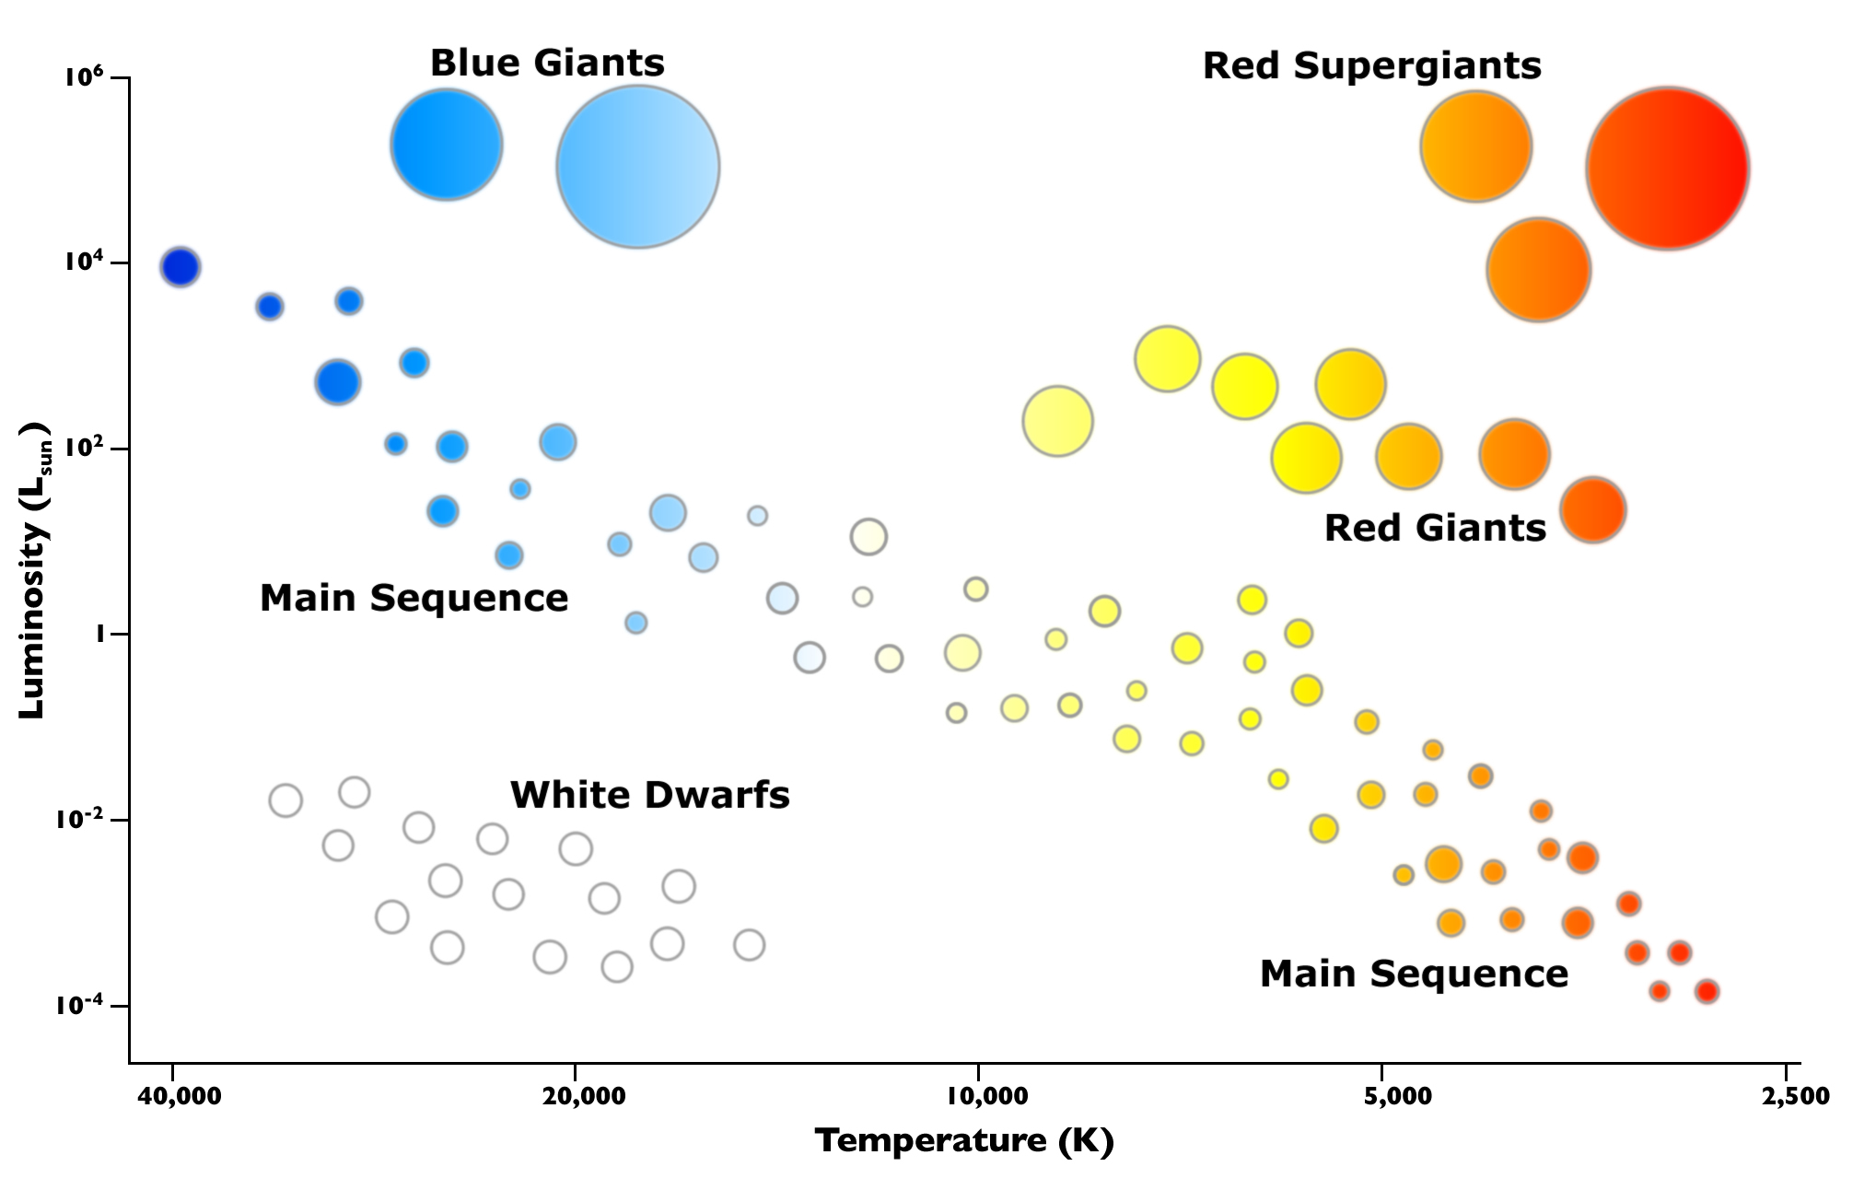
Unsupervised Learning
Clustering of different types of stars

Slide 19
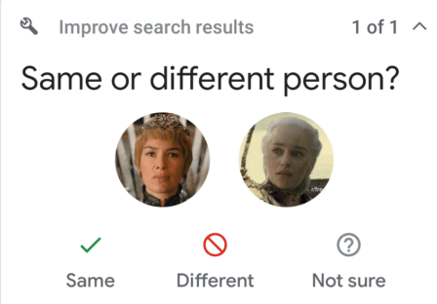
Semi-Supervised Learning
Supervised learning works on labeled data
Unsupervised learning works on unlabeled data
In Semi-Supervised learning, the training data contains both labeled and unlabeled data
We have a large dataset. Manual labeling of the entire dataset is laborious and expensive
One solution could be to label a sample of the dataset and train the labeled portion to create a model. This would however mean that we are not fully utilizing the larger dataset we have and thus the model that we create may be less robust
A potential solution: (1) Label a sample of the large dataset, (2) train a model using this labeled portion, (3) use the model to predict the unlabeled portion (pseudo-labeling), (4) train using the entire dataset
e.g., Google Photos will cluster similar faces, and ask the user if they are the same person

Slide 20
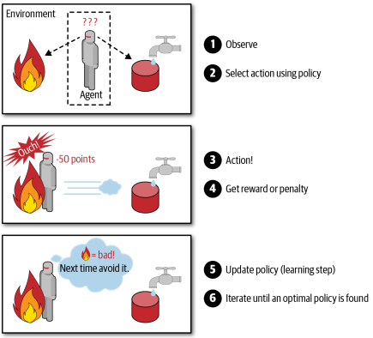
Reinforcement Learning
The learning system (agent) can:
Observe the environment
Agent explores the environment to collect data
Select and perform an action based on environment’s state using policy
Get rewards/penalties for the action
Based on the reward agent will changes its state
Agent aim: Maximize reward
Reinforcement learning differs from supervised learning in a way that in supervised learning the training data has the answer key with it, so the model is trained with the correct answer itself
In reinforcement learning, there is no answer, but the reinforcement agent decides what to do to perform the given task. In the absence of a training dataset, it is bound to learn from its experience
Very effective in controlled environments = dataset (such as a game of chess)
With the progress in deep learning, increasingly used in more complex tasks (such as driving the mars rover, industrial automation)

Slide 21
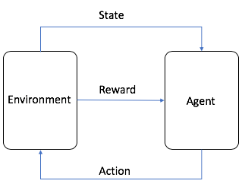
Reinforcement Learning
The agent is the autonomous system
The environment is the adaptive problem space with attributes such as variables, boundary values, rules, and valid actions
The action is a step that the RL agent takes to navigate the environment
The state is the environment at a given point in time
The reward is the positive, negative, or zero value—in other words, the reward or punishment—for taking an action
The cumulative reward is the sum of all rewards or the end value

Slide 22
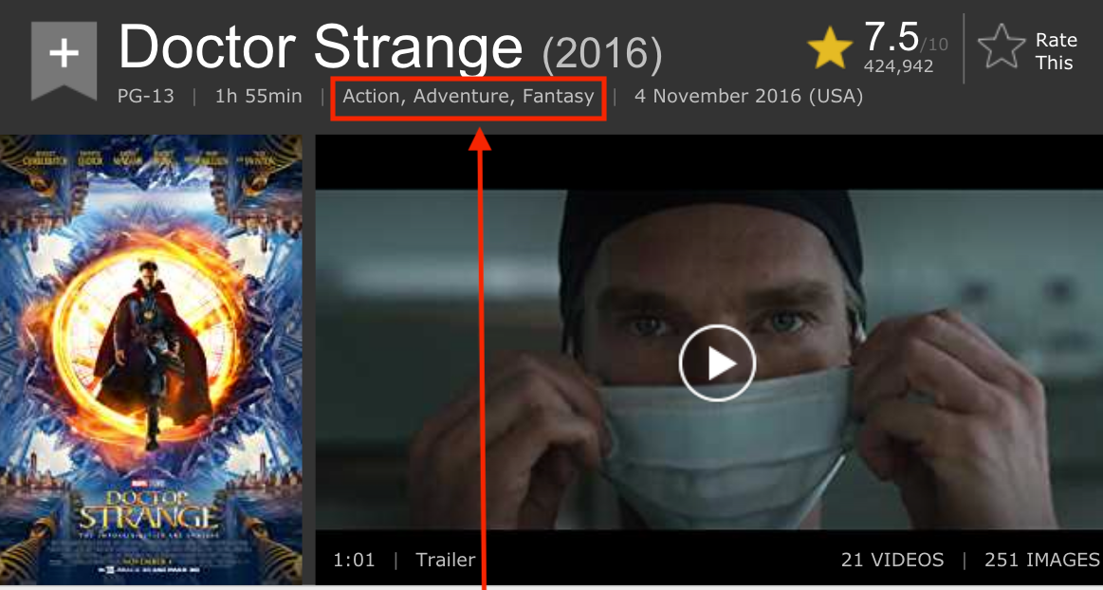
Multilabel Classification
Two or more classes and the data we want to classify may belong to none of the classes or all of them at the same time
Multiple labels to an instance, allowing it to belong to more than one category simultaneously
Multiple tags to a blog post or assigning multiple genres to a movie

Slide 23
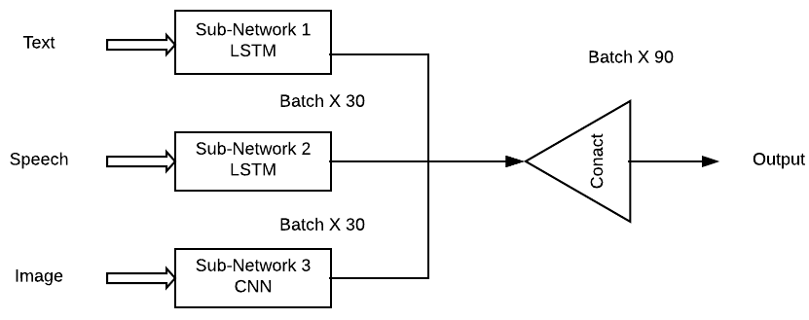
Multimodal Learning
Comprises multiple modalities of data, such as text, audio, or images
More robust than traditional unimodal learning

Slide 24
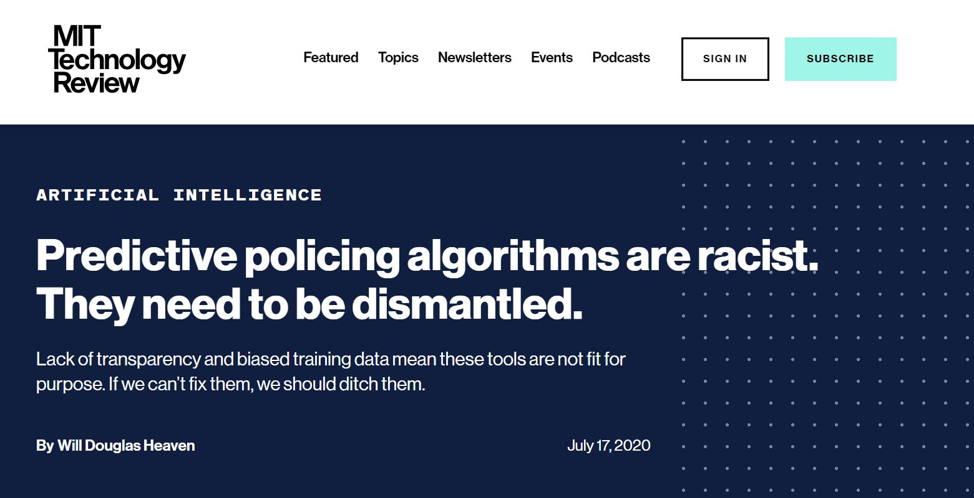
Issues related to AI (and more particularly ML)
ML model depends on the data that is fed.
Bias in the data (conscious / unconscious) can be easily picked up by ML models
ML systems used for criminal risk assessment of NYPD have been found to be biased against black people.
Used to find a person is a potential criminal or not

Slide 25
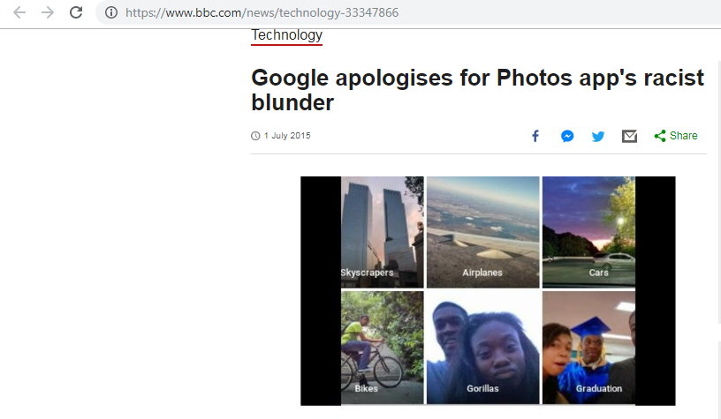
Issues Related to ML

Slide 26
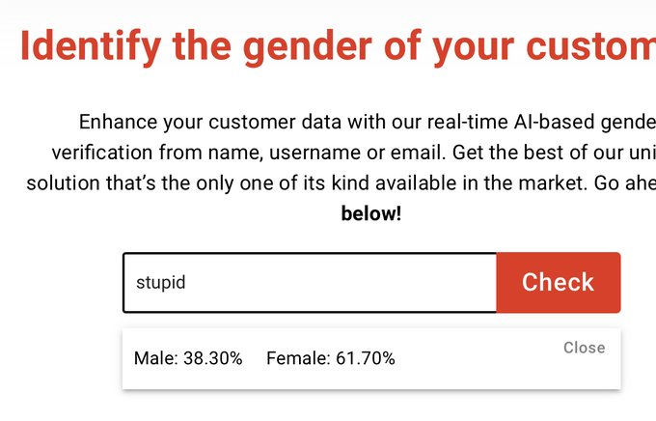
Issues Related to ML
Genderify — designed to identify a person’s gender by analyzing their username or email address
the word “professor,” Genderify predicted a 98.4 percent probability for males. Meanwhile, “stupid” returned a 61.7 percent female prediction

Slide 27
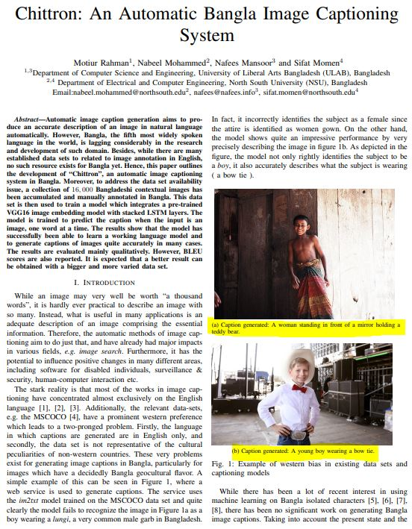

Slide 28
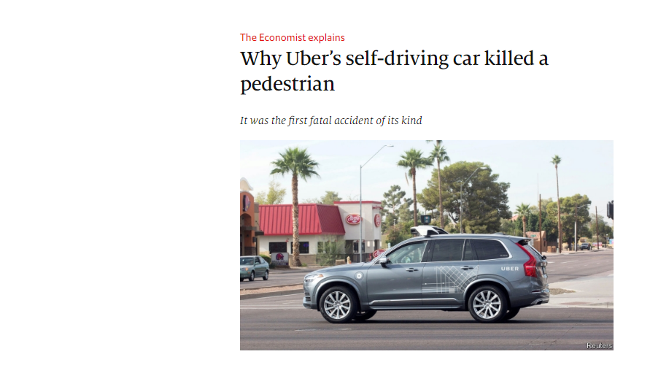

Slide 29
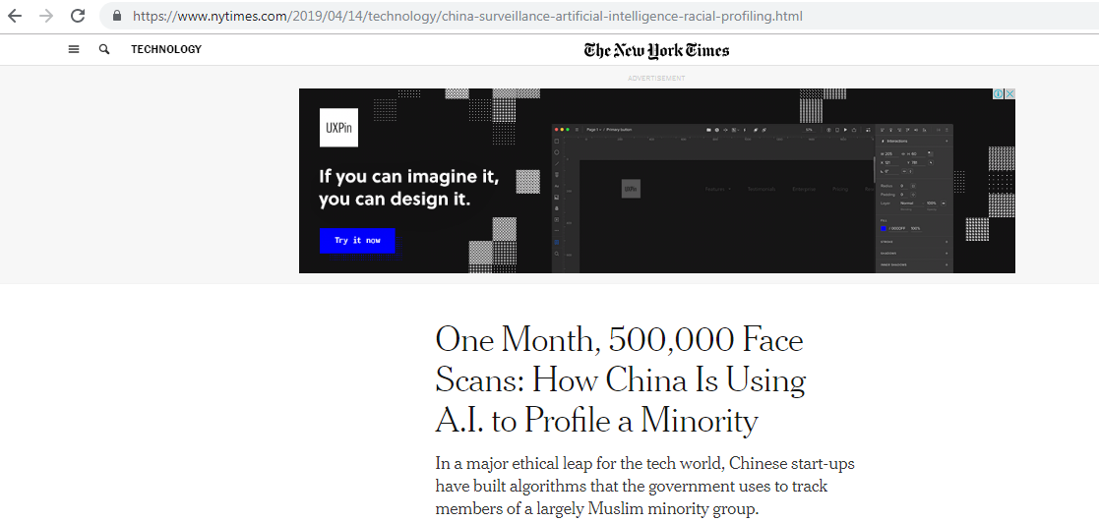

Slide 30
ML and Ethics (More Complex case)
When applied to people, data mining is frequently used to discriminate - who gets the loan, who gets the special offer, and so on.
Certain kinds of discrimination - racist, sexual, religious and so on are not only unethical but also illegal.
Using sexual and racist information for medical diagnosis is certainly ethical but using the same information when mining loan payment behavior is not.

Slide 31
ML and Ethics (Difficulty to solve it)
Reidentification techniques has provided sobering insights into the difficulty of anonymizing data.
85% of the Americans can be identified from just three pieces of information, zip code, birth date and sex.

